Slide 1
Welcome to the
Web Application Development with Python L-4
Training Program

Slide 2
Lecture
Python List
08

Slide 3
Python List
A list is a built-in data structure in Python that allows you to store multiple items in a single variable.
Lists are ordered
mutable (can be changed)
allow duplicate values.
Lists are created using square brackets:
studentlist = [“rohim”, 100, True, “Korim”, 5.5]

Slide 4
Why Use Lists?
Lists are used to:
Store multiple values in a single variable
Access elements using index
Modify, add, or remove elements
Perform operations on collections of data

Slide 5
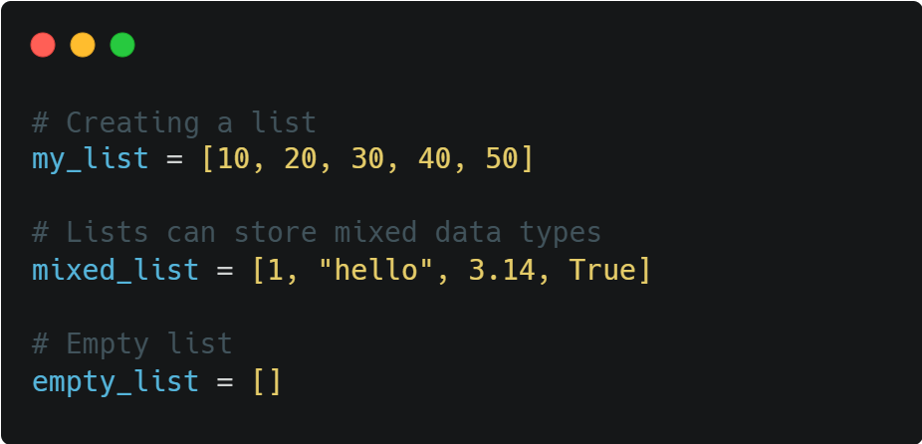
Creating a List
Lists are created using square brackets [ ].

Slide 6

Access List Element
List elements are accessed using index numbers (starting from 0). The index of first item is 0, the index of second item is 1, and so on.

Slide 7
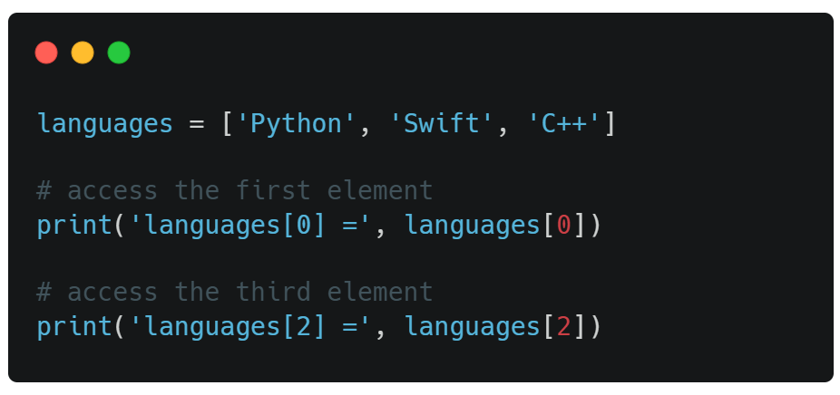

Access List Element

Slide 8
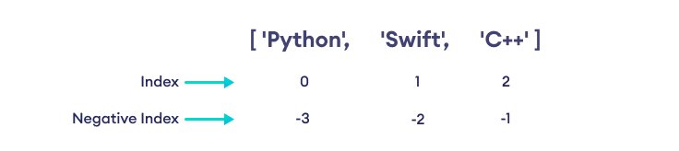
Negative Indexing
In Python, a list can also have negative indices. The index of the last element is -1, the second last element is -2 and so on.

Slide 9
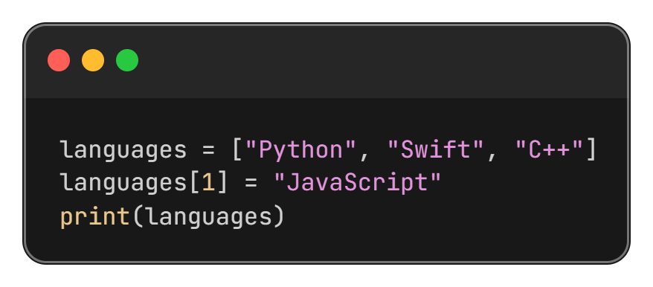
Changing List Items
Lists are mutable, so values can be changed.

Slide 10
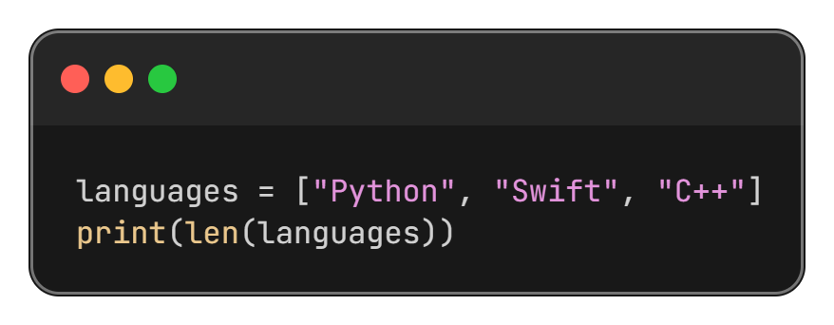
List Length
Use the len() function to find the number of elements

Slide 11
Adding Elements to a List

Slide 12
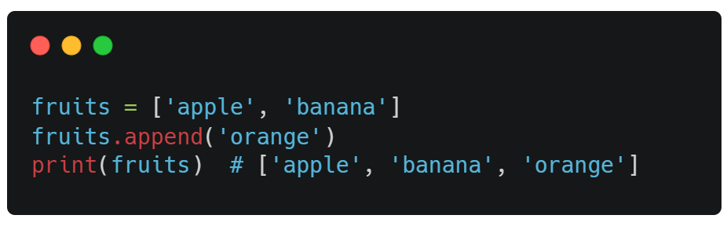
append(item) Method
Adds a single item to the end of the list

Slide 13
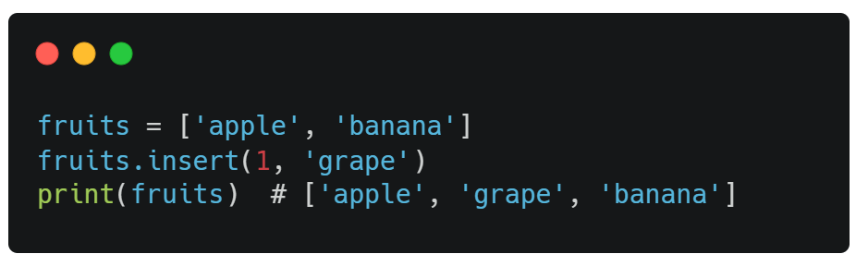
insert(index, item) Method
Inserts an item at the specified index

Slide 14
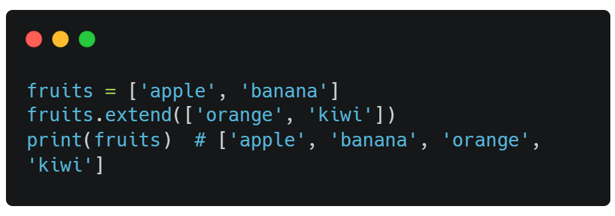
extend(list) Method
Add the element of a list to the end of the current list

Slide 15
Removing Elements from a List

Slide 16
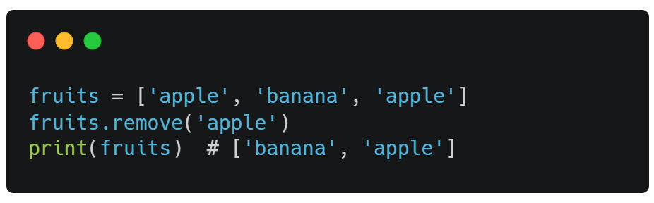
remove(item) Method
Removes the first occurrence of a value

Slide 17
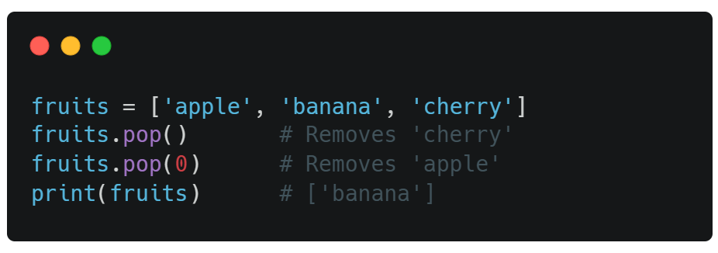
pop([index]) Method
Removes the element at the specified position
Note: If we not provide index it’s remove the last element

Slide 18
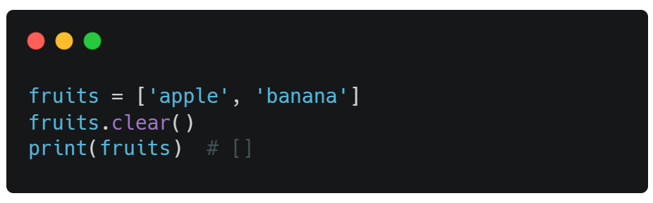
clear() Method
Removes all items from the list.

Slide 19
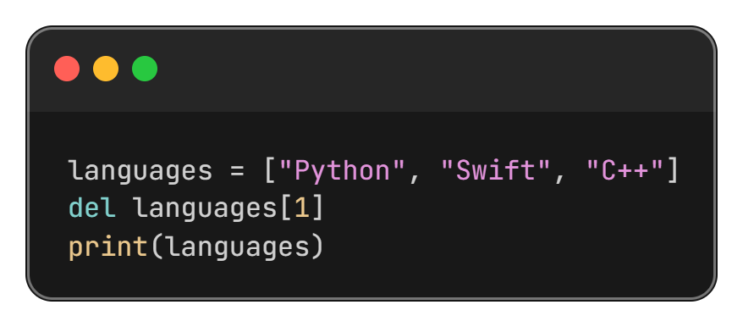
del Keyword
Remove specific index or a variable.

Slide 20
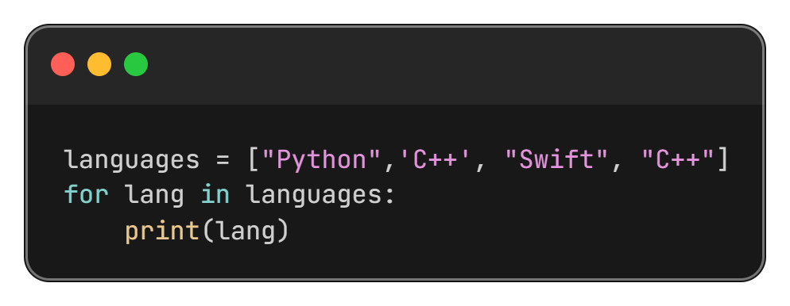
Using for Loop

Slide 21
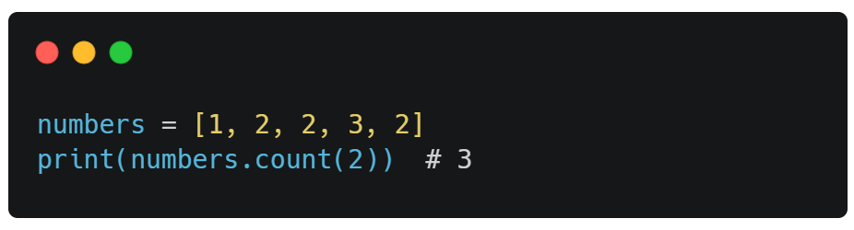
count() Method
Returns the number of elements with the specified value.

Slide 22
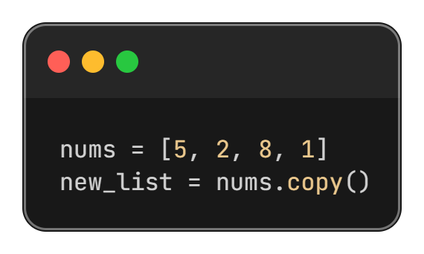
copy() method
Duplicate or copy a list using this method.

Slide 23
Thanks All

